Slide 1
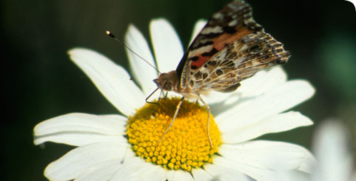
Biodiversity

Slide 2
Biodiversity, which is short for biological diversity, is the term used to describe the whole variety of life on Earth
Biodiversity encompasses the diversity of all living things, from human beings to micro-organisms, the diversity of all the habitats in which they live and the genetic diversity of individuals within a species

Slide 3
How Many Species on Earth? 8.7 Million
estimated total number of species on Earth -- the most precise calculation ever offered -- with 6.5 million species found on land and 2.2 million dwelling in the ocean depths

Slide 4
Types of biodiversity
Genetic diversity Each member of any animal or plant species differs widely from other individuals in its genetic makeup because of the large number of combinations possible in the genes that give every individual specific characteristics. Thus, for example, each human being is very different from all others.

Slide 5
Species diversity The numbers of species of plants and animals that are present in a region constitutes its species diversity. This diversity is seen both in natural ecosystems and in agricultural ecosystems. Some areas are more rich in species than others. Areas that are rich in species diversity are called ‘hotspots’ of diversity. India is among the world’s 15 nations that are exceptionally rich in species diversity.

Slide 6
Ecosystem Diversity Ecosystem diversity can be described for a specific geographical region, or a political entity such as a country, a State or a taluka. Distinctive ecosystems include landscapes such as forests, grasslands, deserts, mountains, etc., as well as aquatic ecosystems such as rivers, lakes, and the sea. India is exceptionally rich in ecosystem diversity.

Slide 7
Value of Biodiversity
Economic values of Biodiversity
Biodiversity supply food – key to food security
Biodiversity provides drugs and medicines
Biodiversity promoted tourism-eco tourism
Biodiversity provides fibre
Biodiversity provides building material
Bio fuels as products of Biodiversity

Slide 8
Ecological values of Biodiversity
plays important role in hydrological cycle
helps in soil formation
helps nutrient recycling
reduces pollution
maintains climate balance
helps in research

Slide 9
Aesthetic and cultural benefits
enjoys outdoors activities based on nature
offer prayers to forest, rivers, mountains, animals etc – animals like cow, snake, peacock etc have important place in spiritual area.

