Slide 1
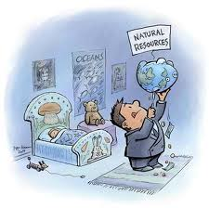

Slide 2
Resources “Means to attain given ends”. Any material which is required or used to sustain life or livelihood is termed as a resource. In other words the term resources means anything whether natural or human or cultural, which satisfies human wants.

Slide 3
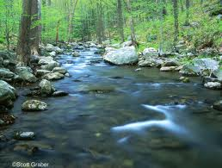
It must be noted that man cannot create anything, except his own species like all other forms of life. All the resources are created by the nature. Man’s skill and intelligence helps to discover many natural resources. Once man knows the presence and use of resources, he finds out the ways and means of exploiting them.

Slide 4
Resources
Natural
Exhaustible
Limited both qualitative and quantitative
Human
Skill
Inexhaustible
Unlimited – quality can be degraded, not quantity like air and water

Slide 5
Exhaustible
renewable
Automatically renewable like air and water
Renewable only with efforts of man like forest, fish, soil etc
Non renewable like minerals, power etc
Recyclable like gold, silver, iron, steel etc
Non-recyclable

Slide 6
Why Environment problem?
Greed
Poverty
Ignorance

Slide 7
Rivers : The major rivers flowing through the state are Mandovi, Zuari, Terekhol, Chapora and Betul. The other major rivers include the Tiracol, Chapora, Sal and the Talpona.

Slide 8
Forests : The state has a total forest cover of more than 1,424 sq. km covering almost one-third of the total area. Coconut trees are present in almost the whole of Goa except in the upper regions. Goa’s vegetation also includes cashew, mango, jackfruits and pineapples.

Slide 9
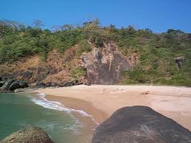
Minerals : Goa is rich in mineral resources. Major minerals include iron ore, manganese, ferro-manganese, bauxite and silica sand. Iron and manganese mining industries are the backbone of Goa’s economy.

